Slide 1


MTN.NIX
Zabbix
Monitoring System
(v3.2)
WEB
Author: Siarhei Beliakou
email: siarhei_beliakou@epam.com
2017

Slide 2

Agenda
Web monitoring
Scenarios
Configuration

Slide 3
web monitoring with Zabbix

Slide 4
Create scenario
Configuration → Hosts (or Templates), Web, “Create scenario”
https://www.zabbix.com/documentation/3.2/manual/web_monitoring
https://www.zabbix.com/documentation/3.2/manual/web_monitoring/example

Slide 5
Fill steps

Slide 6
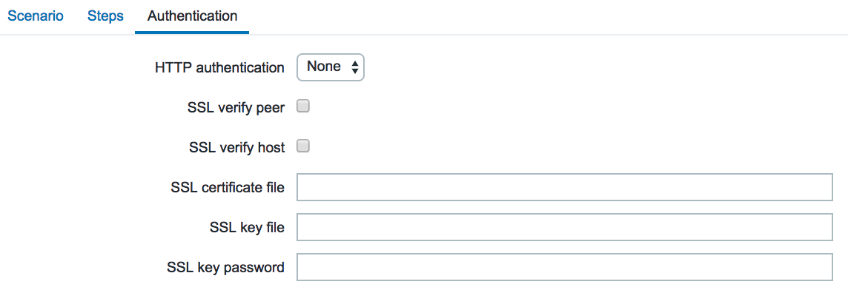
Configure authentication

Slide 7
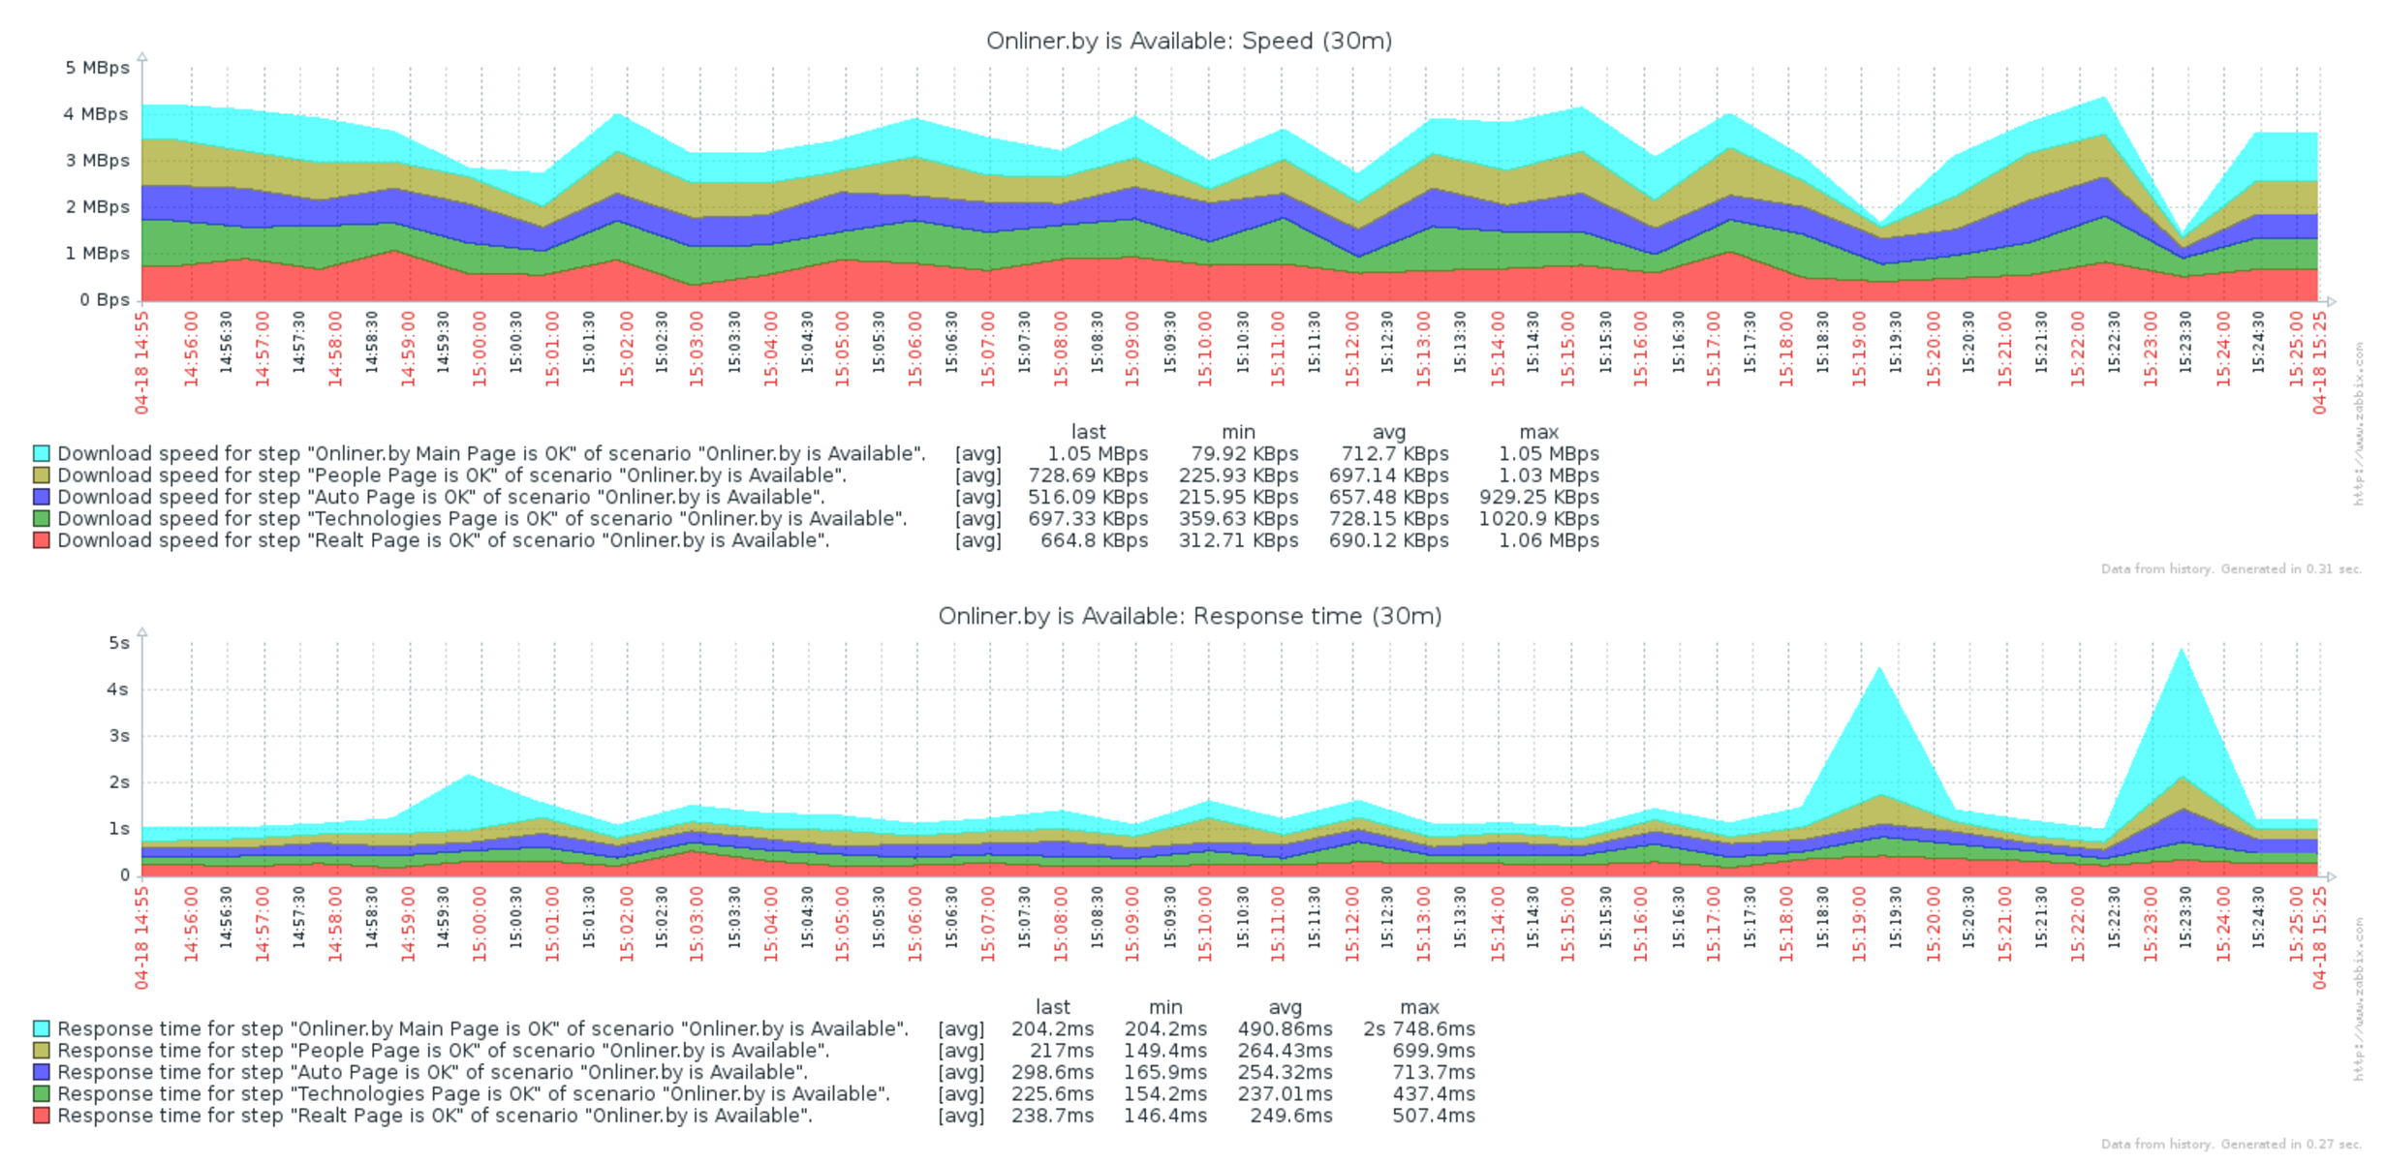
Check results

Slide 8
Homework

Slide 9
homework
Testing Infrastructure:
Vagrantfile to spin up 2 VMs (virtualbox):
zabbix server, provisioned by Vagrant provisioner
Zabbix agents on both VMs, provisioned by Vagrant provisioner
Install Tomcat 7 on 2nd VM, deploy any “hello world” application
Tasks:
Configure WEB check:
Scenario to test Tomcat availability as well as Application heath
Configure Triggers to alert once WEB resources become unavailable
For both VMs use vagrant box “sbeliakou/centos-7.3-x86_64-minimal”

Slide 10
MTN.NIX
Thanks for Your Attention!
Questions?
Siarhei Beliakou
2017

